Slide 1
Savannah’s Thesis Graphs Progress
Elevations and Sediment Deposition Over Months and Distances (M1-M6!)

Slide 2
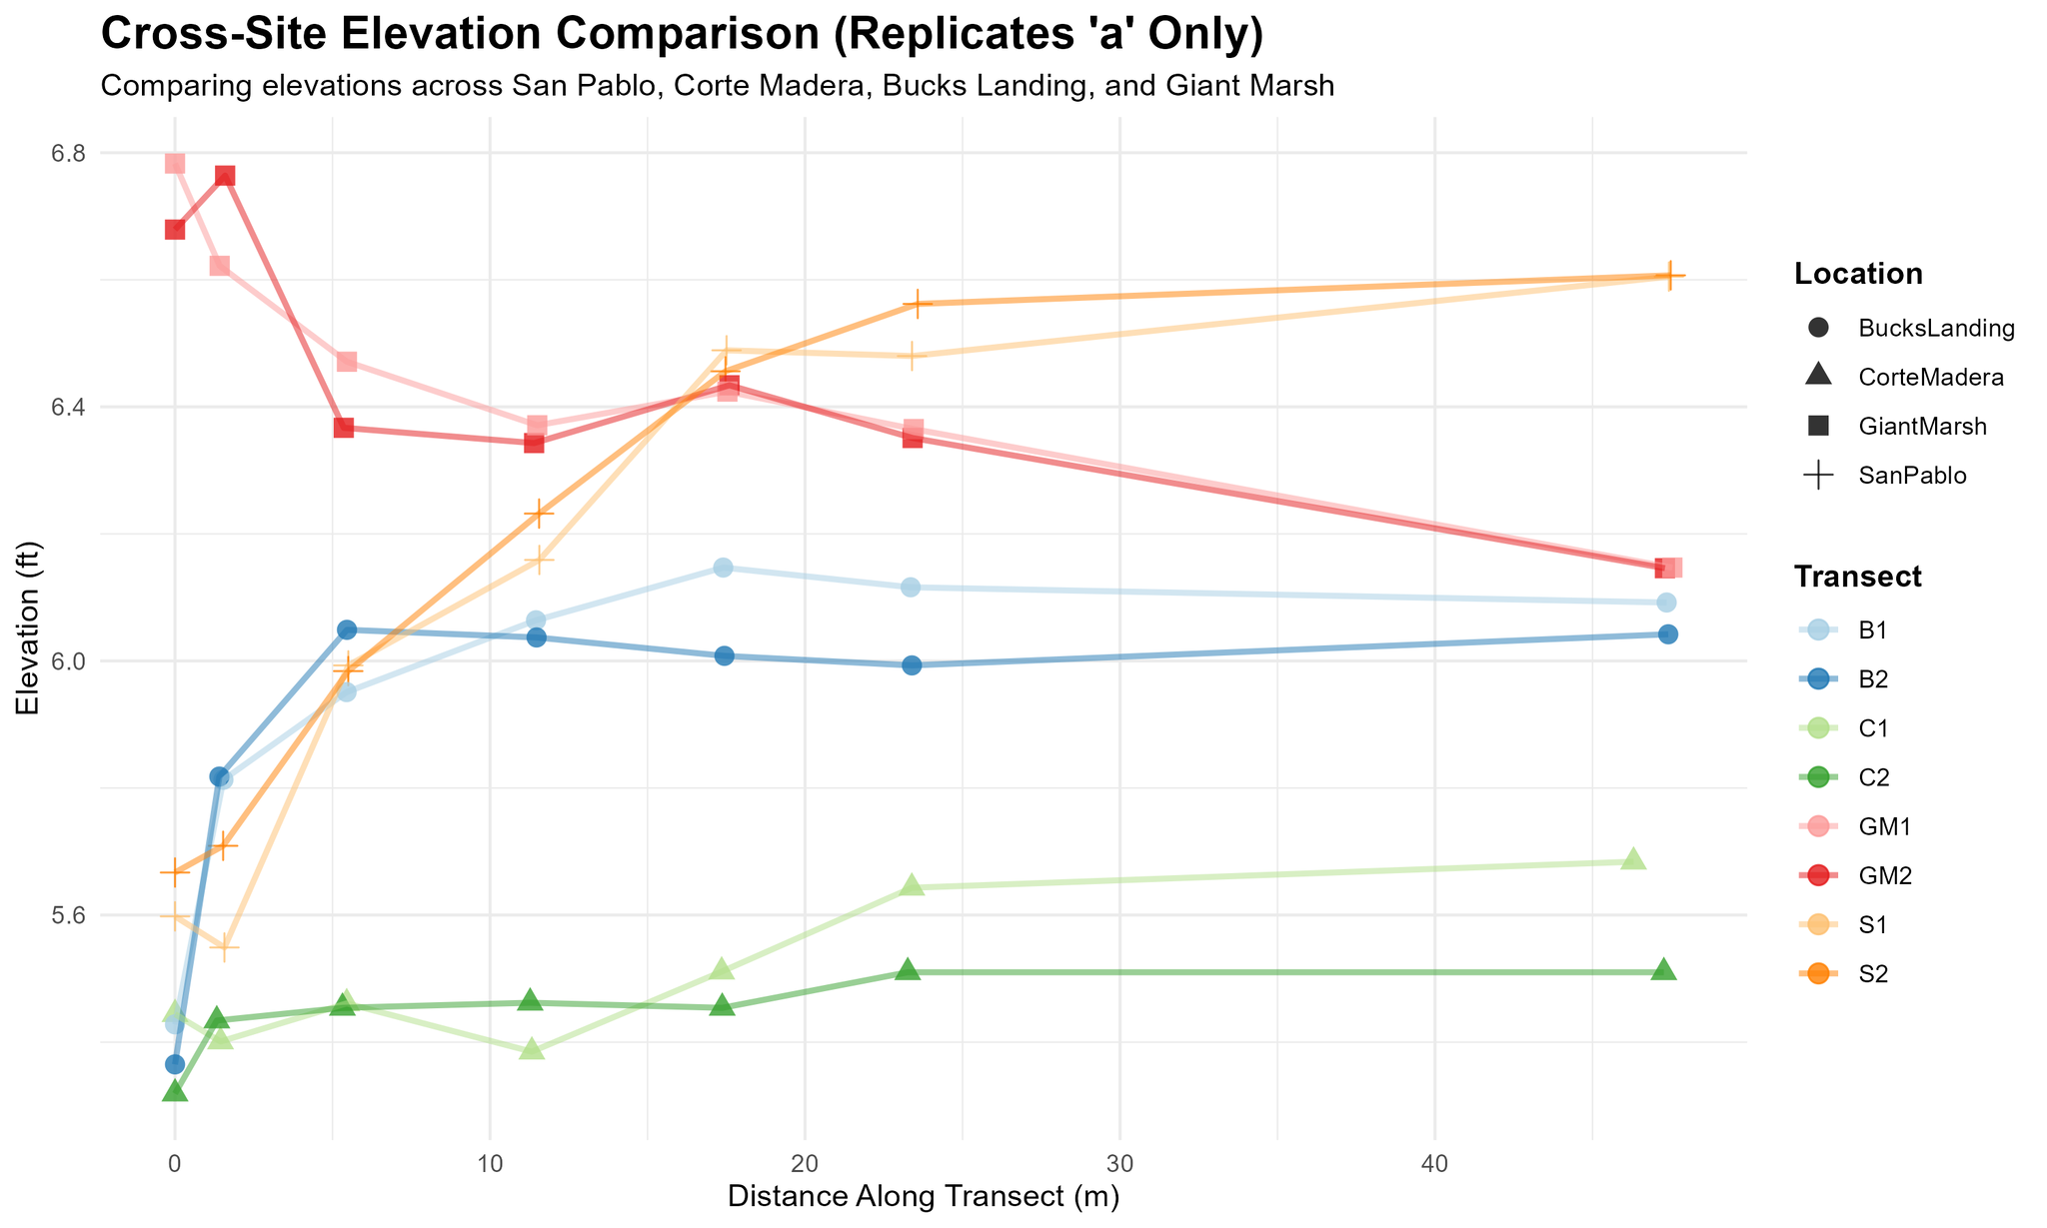
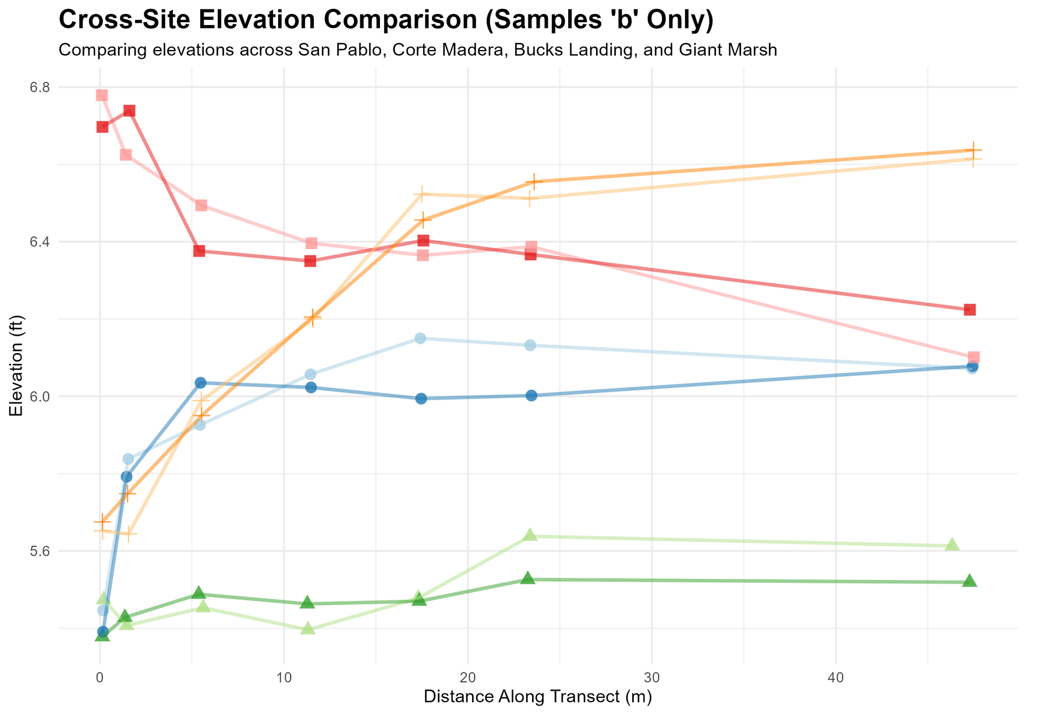
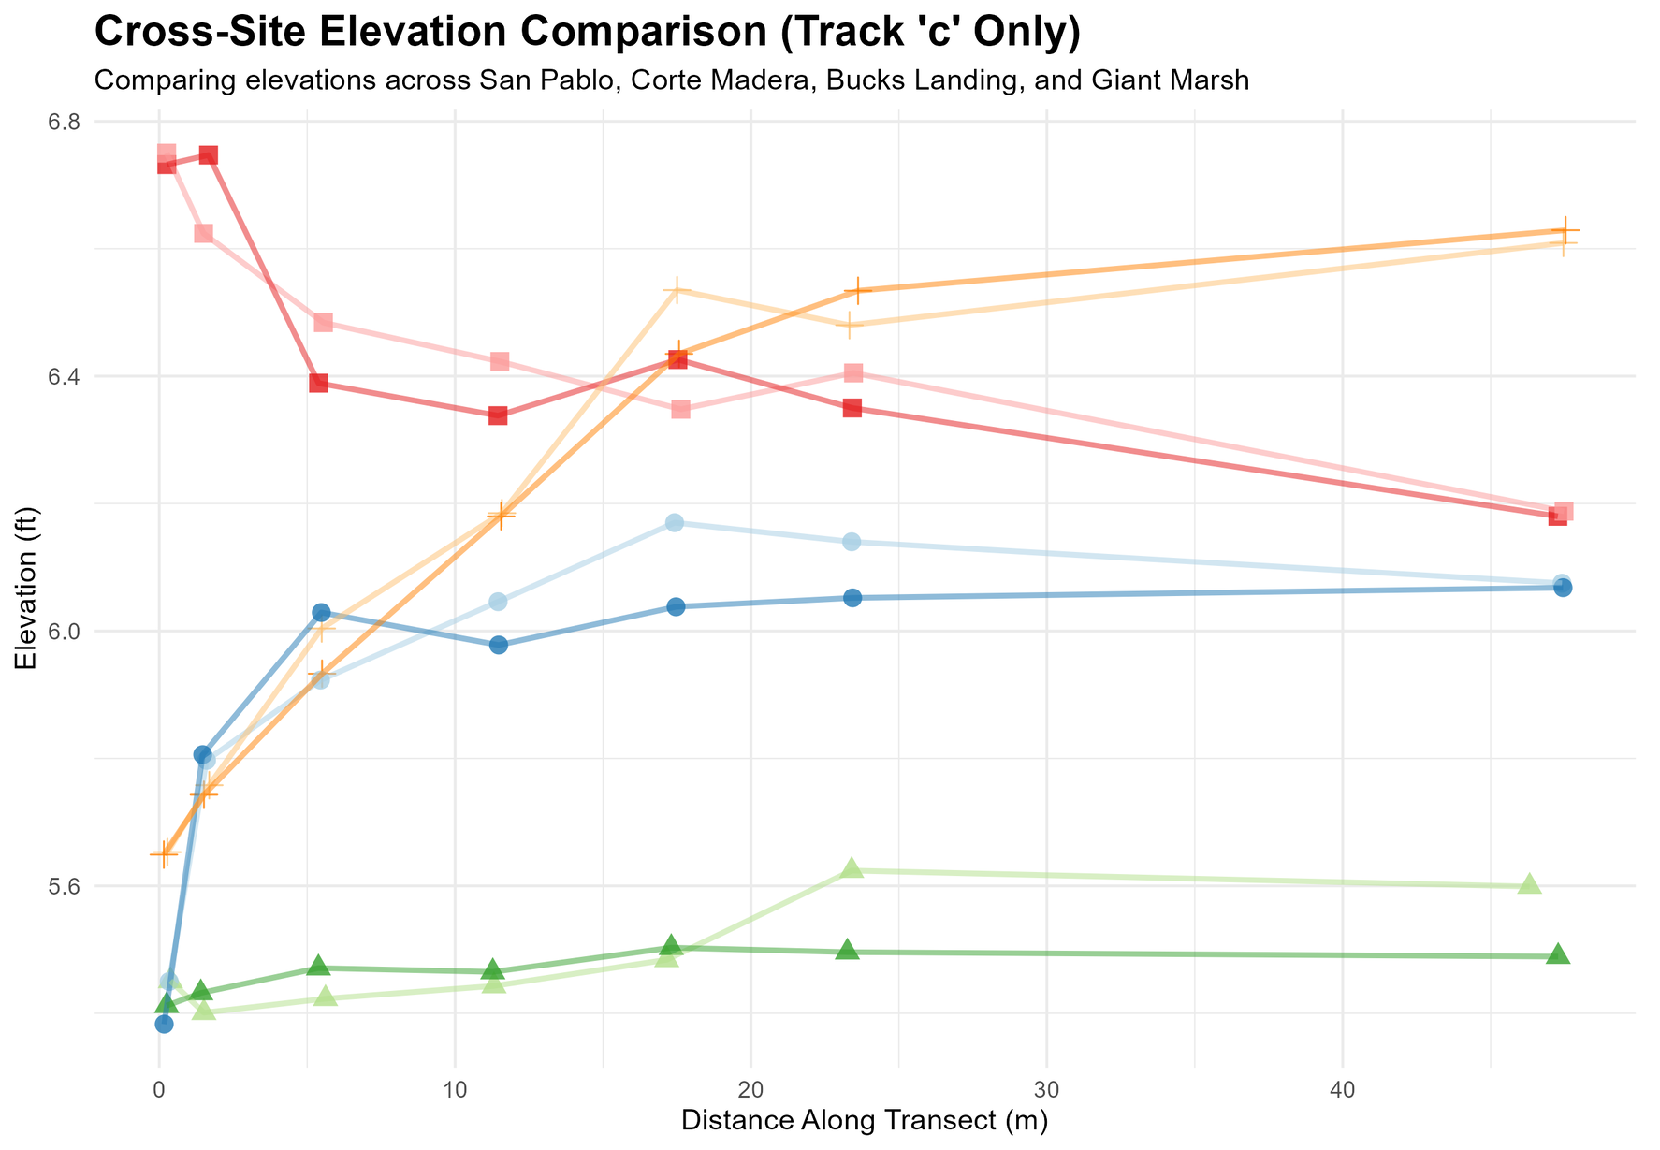
Elevation Comparison of Replicates Between Transects and Sites
Generally appears that replicates don’t differ from each other in terms of elevation.
Need to see what tests or statistical tests to run to see how much differing is significant in this context.

Slide 3
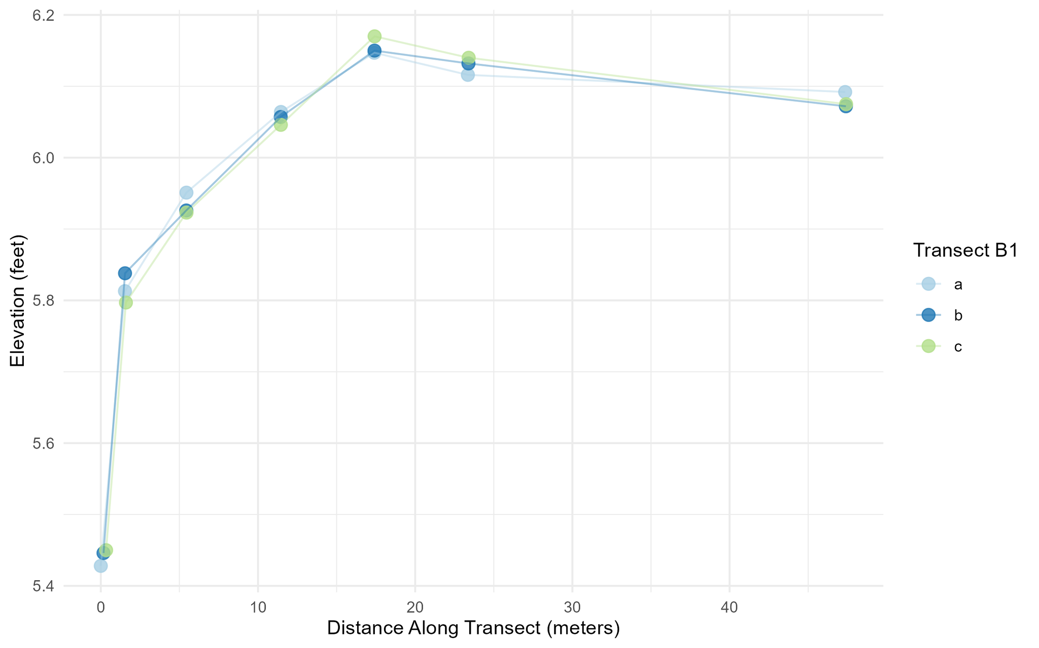
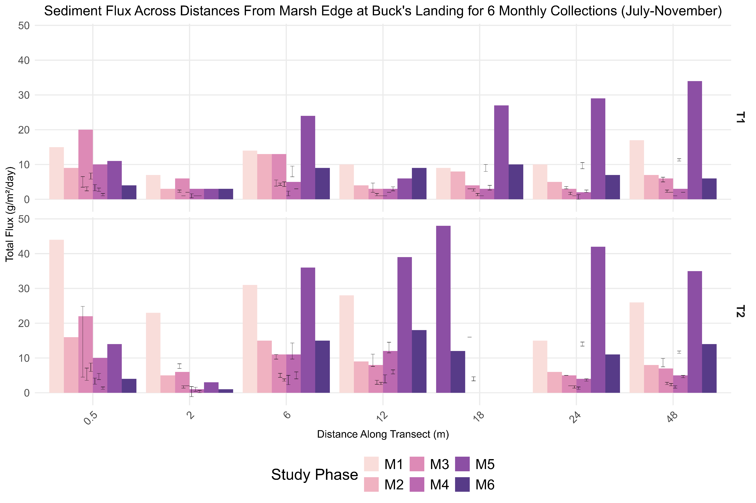
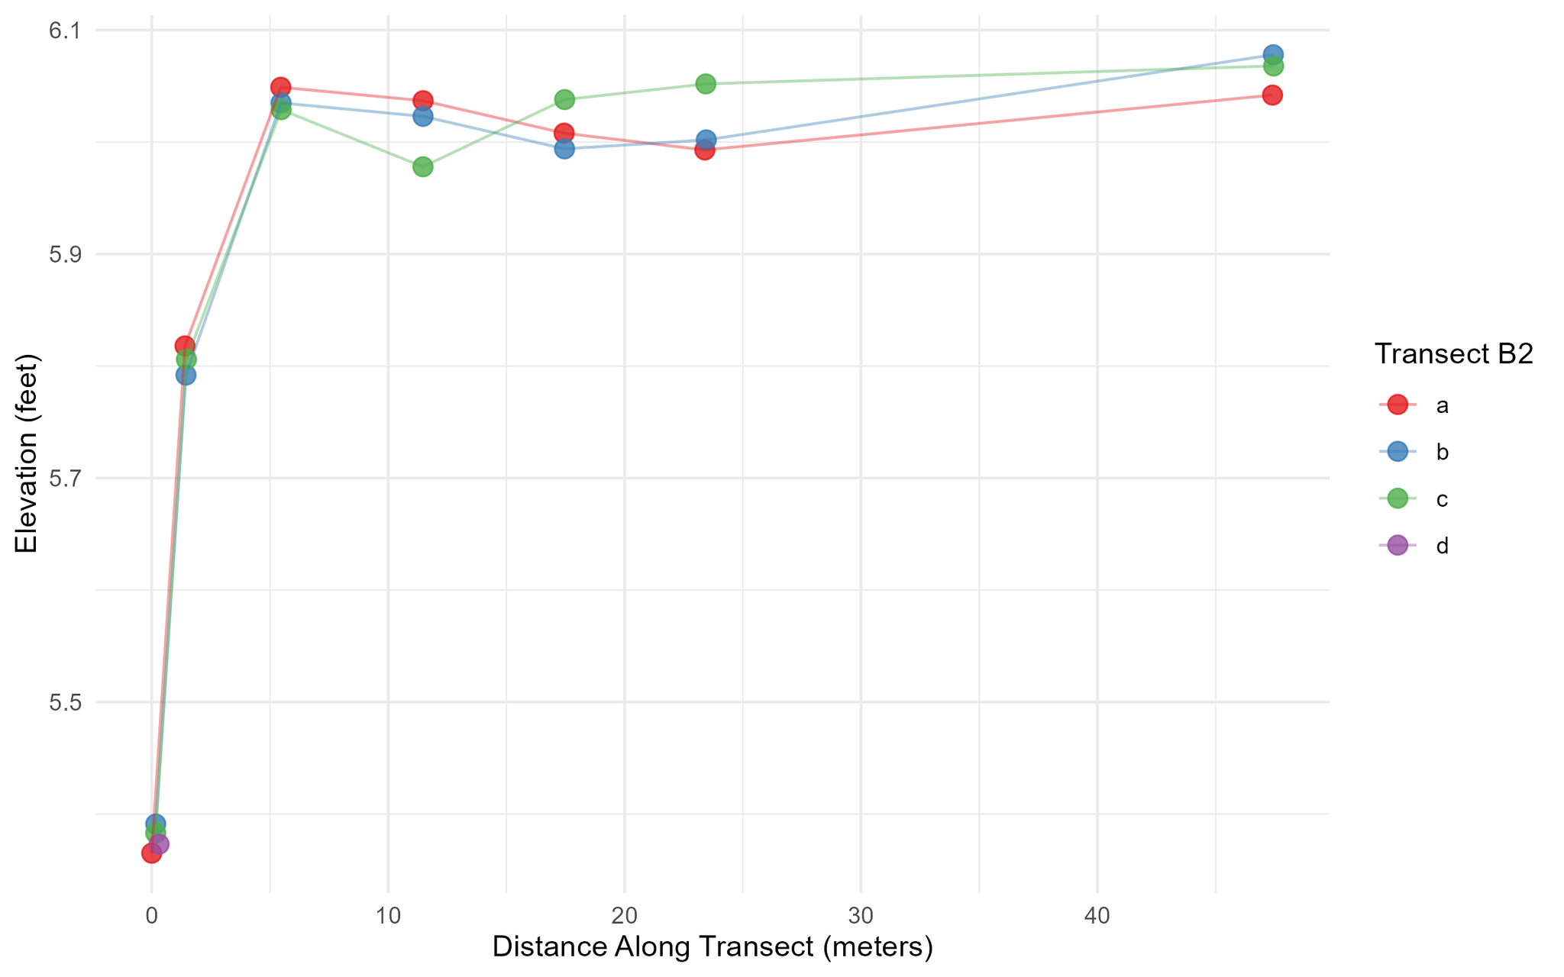
Buck’s Landing:
Comparing Elevations and Sediment Deposition Among Transects
Transect shape is slightly different but general shape within similar elevations. Transect 2 almost has a scarp-closest in location to tidal creek.
Very similar patterns of sediment deposition across transects except around 18 and 24 meters.

Slide 4
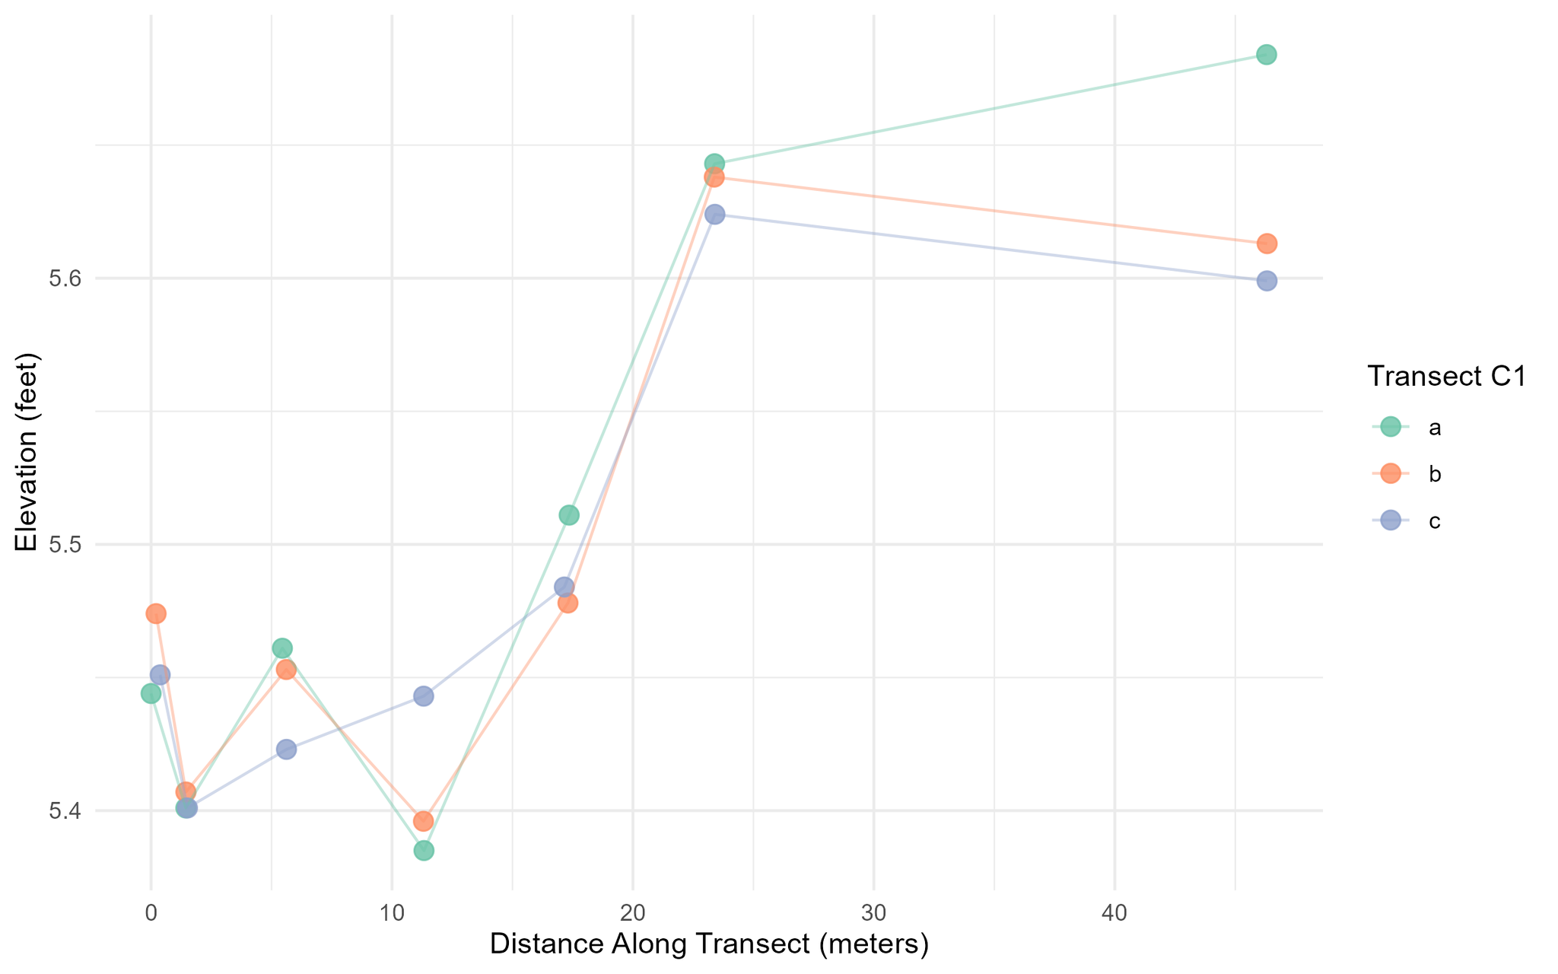
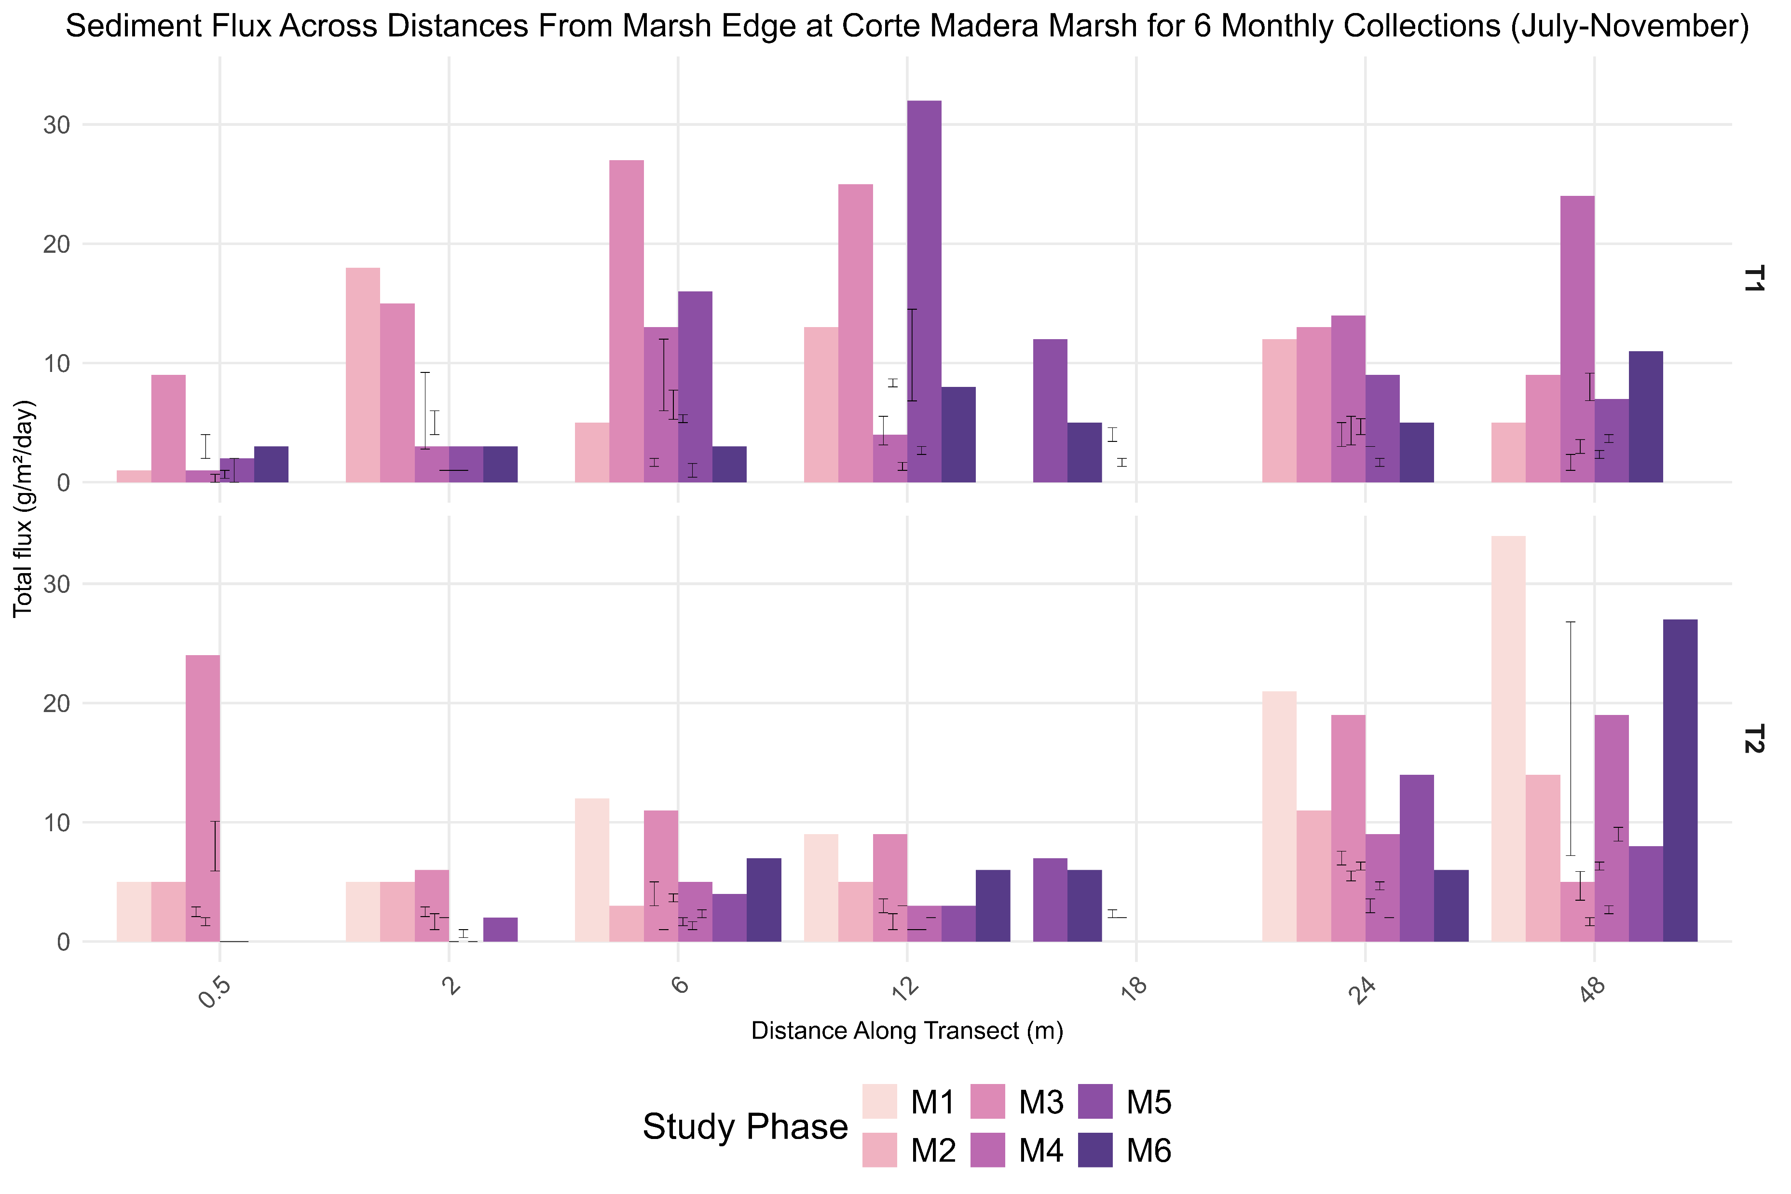
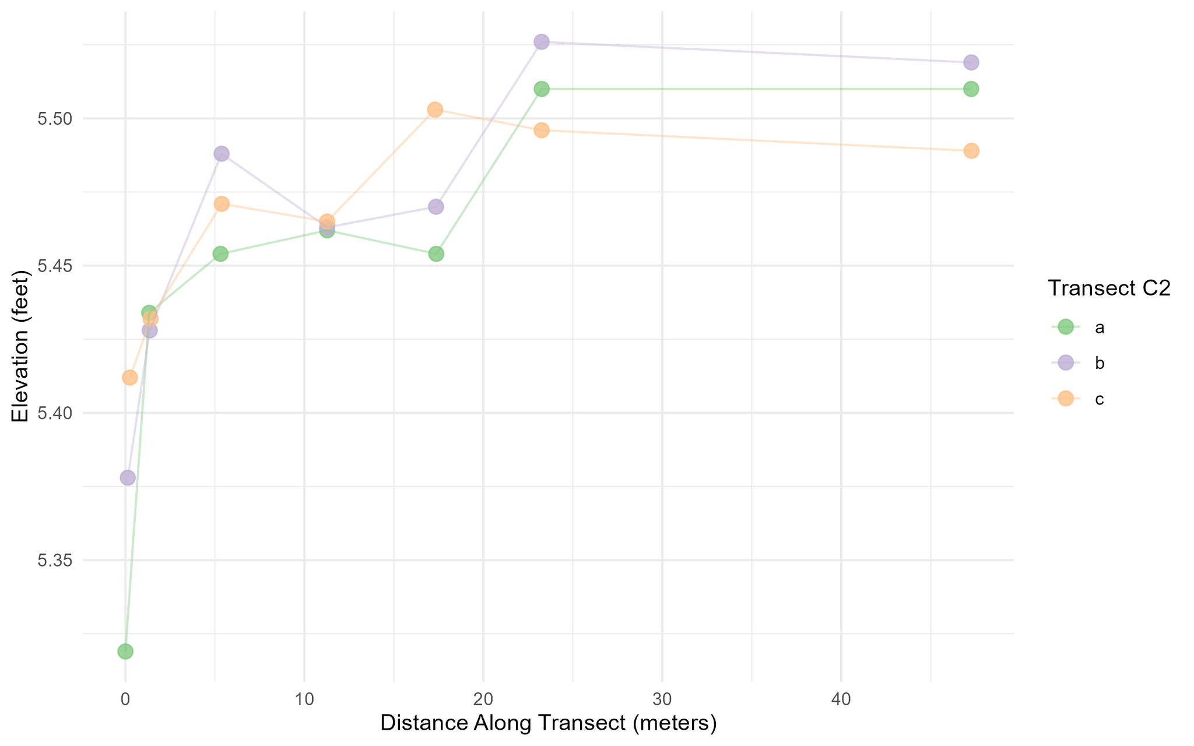
Corte Madera:
Comparing Elevations and Sediment Deposition Among Transects
Both transects have a very different shape, but elevation differences are very subtle with ~ 0.1 scale differences
Very different patterns of sediment deposition across months and distances between transects.

Slide 5
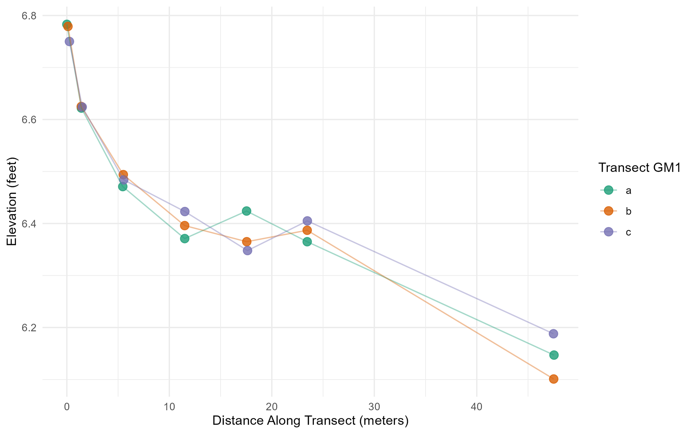
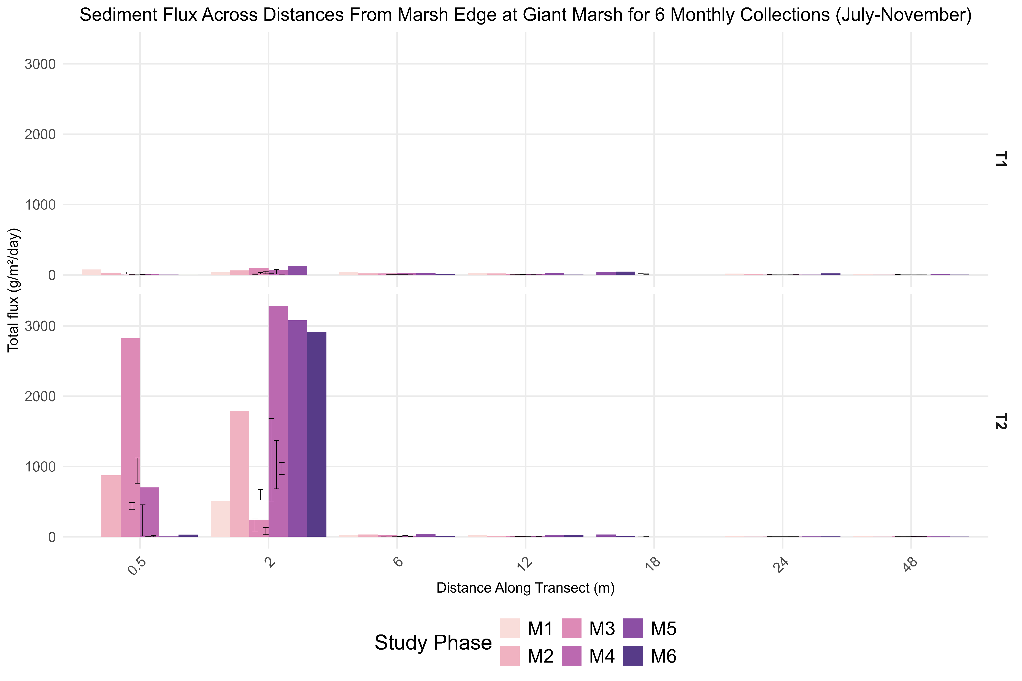
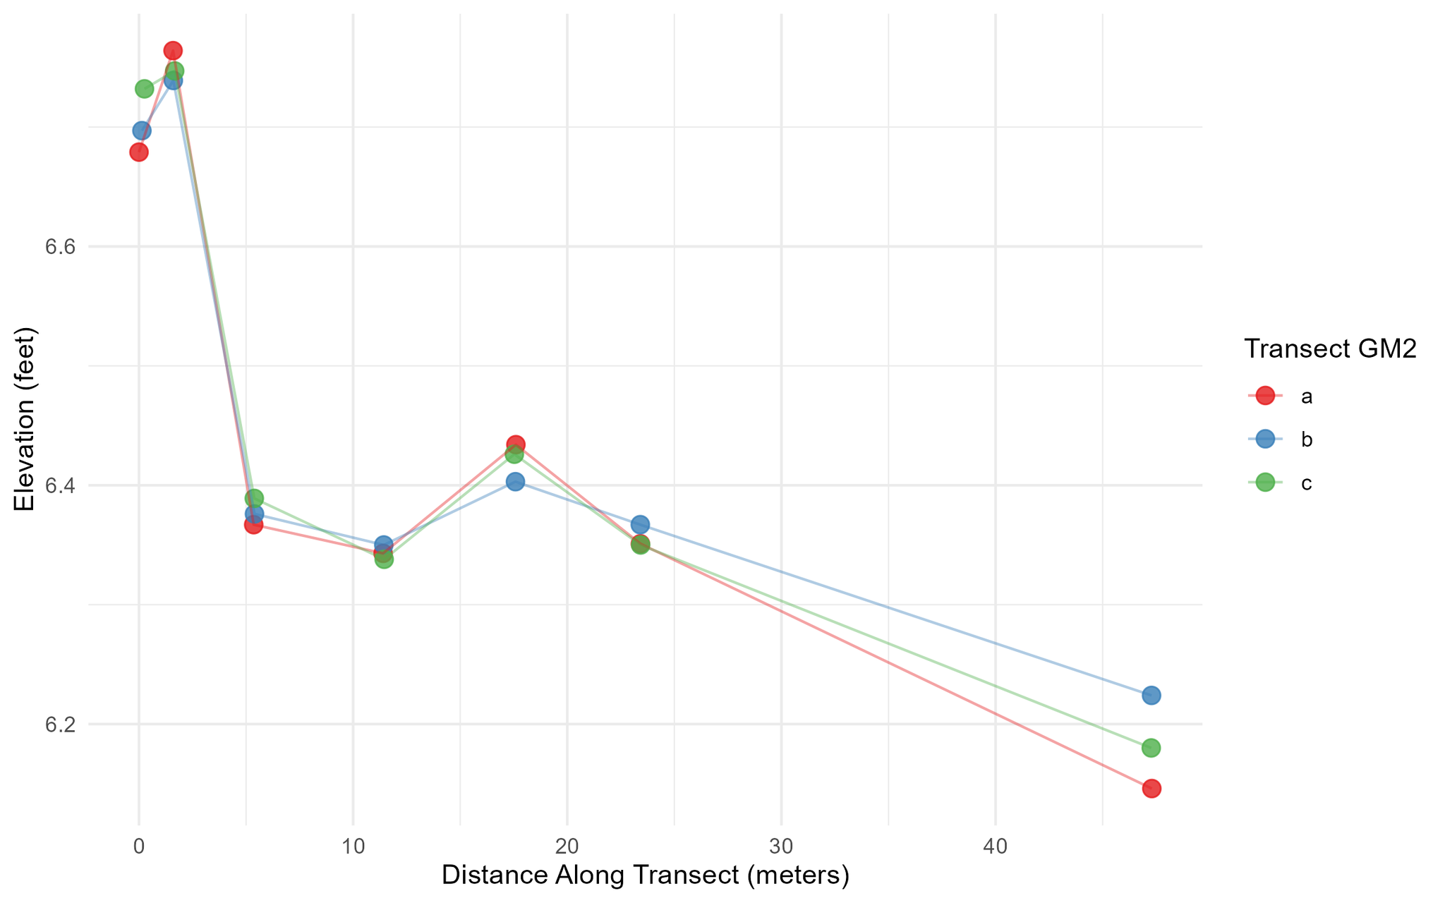
Giant Marsh:
Comparing Elevations and Sediment Deposition Among Transects
Transect 1 does not have a lip at the marsh edge as does Transect 2.
Will need to scale Transect 1 data better

Slide 6
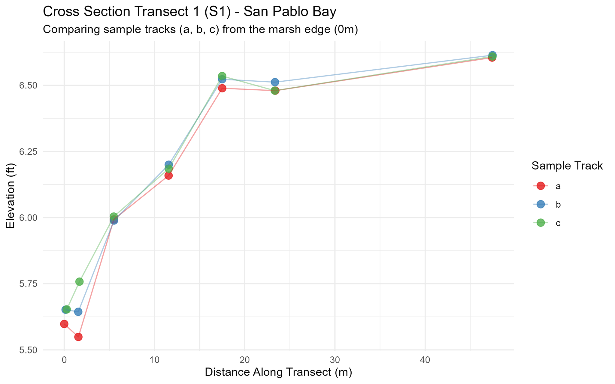
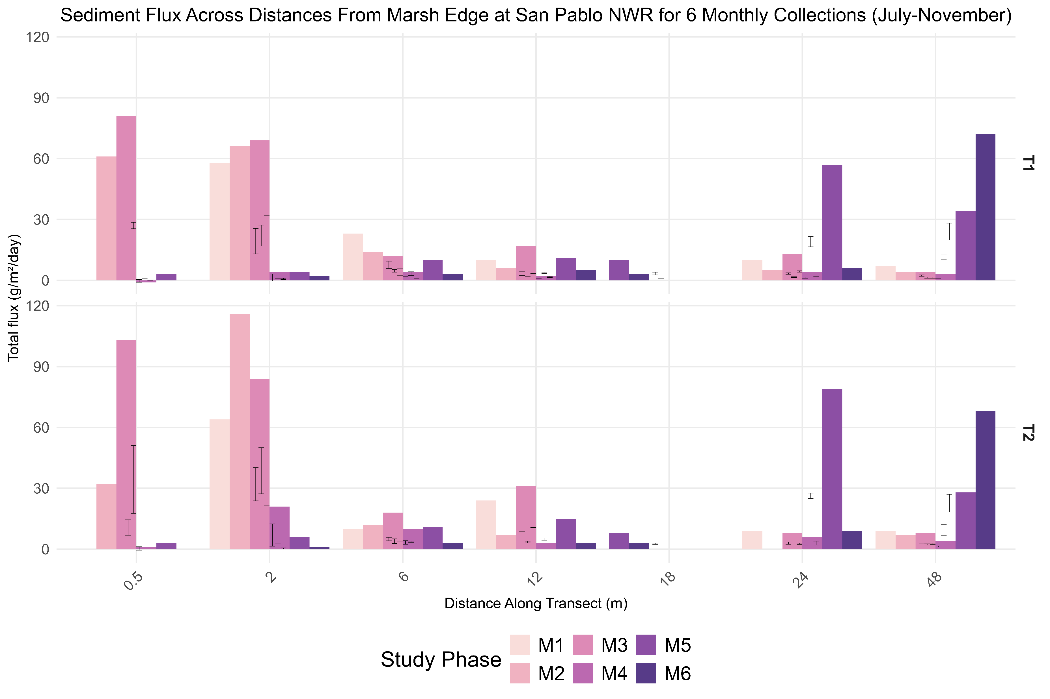
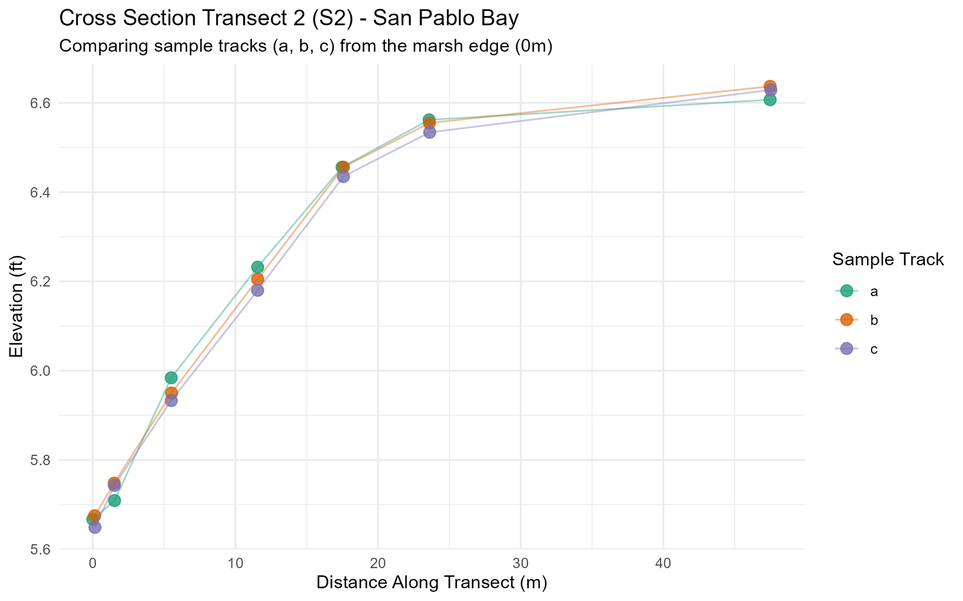
San Pablo NWR:
Comparing Elevations and Sediment Deposition Among Transects
Transects shape slightly different, but both morphology and sediment deposition appears similar in both transects.
Month 4 and 6 had higher deposition at further distance along transect

Slide 7
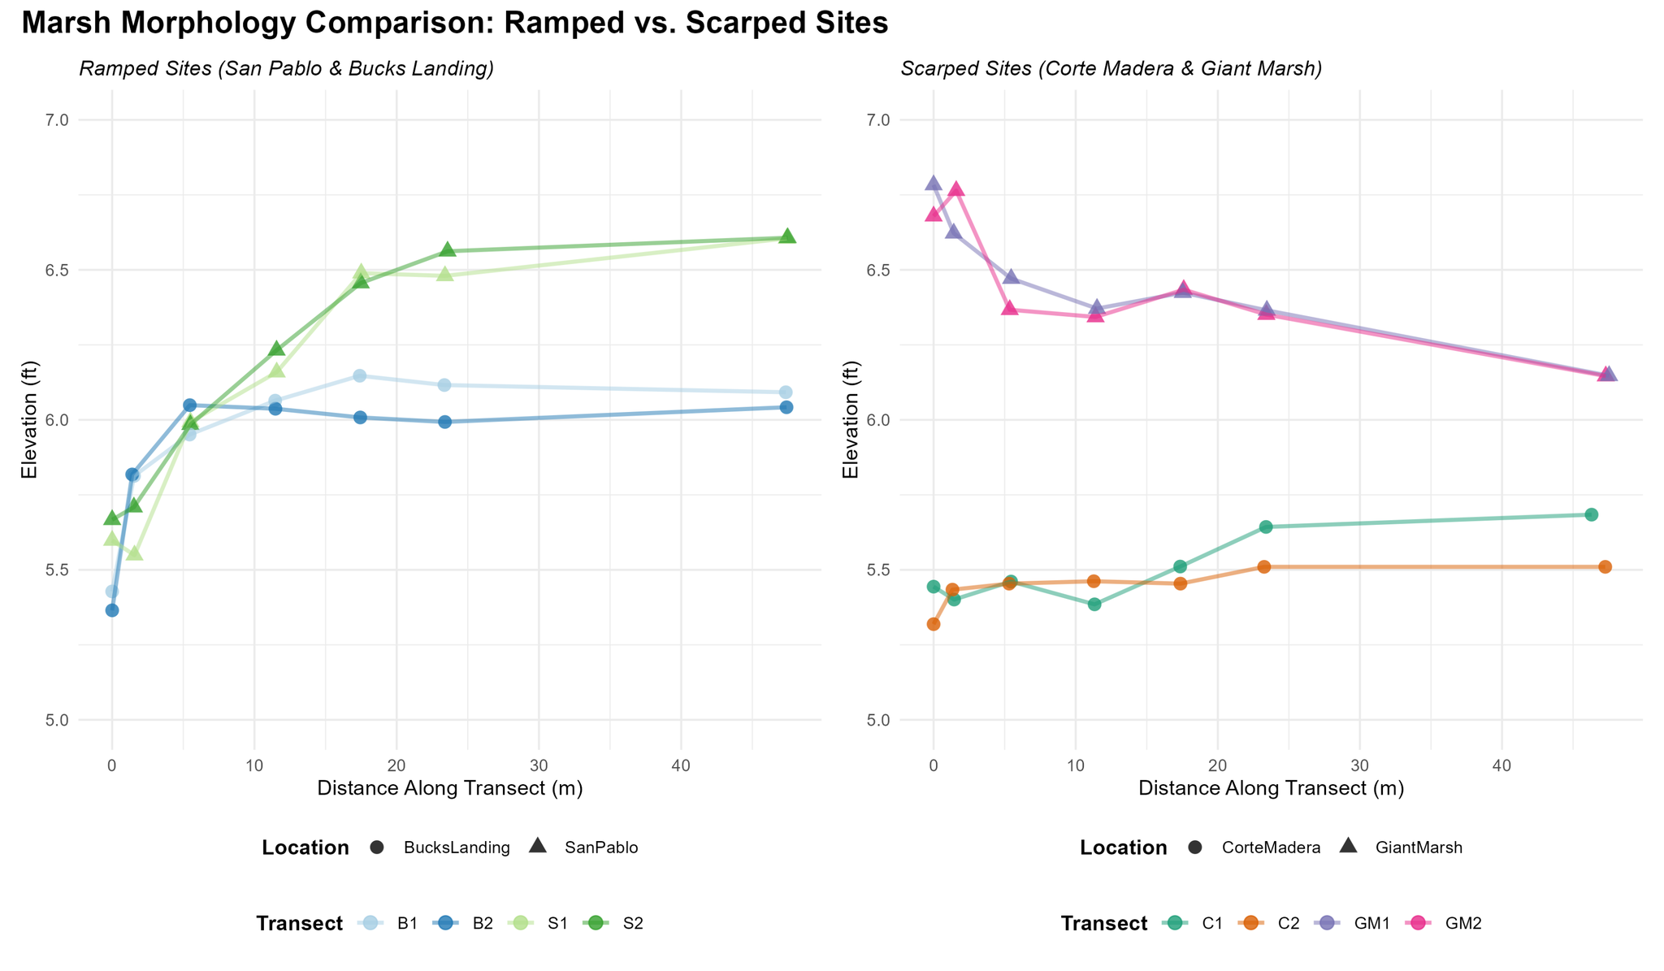
Ramped Sites: Difference of ~ 0.5 feet difference in elevation
Scarped Sites: Difference of ~ 1 foot difference in elevation

Slide 8
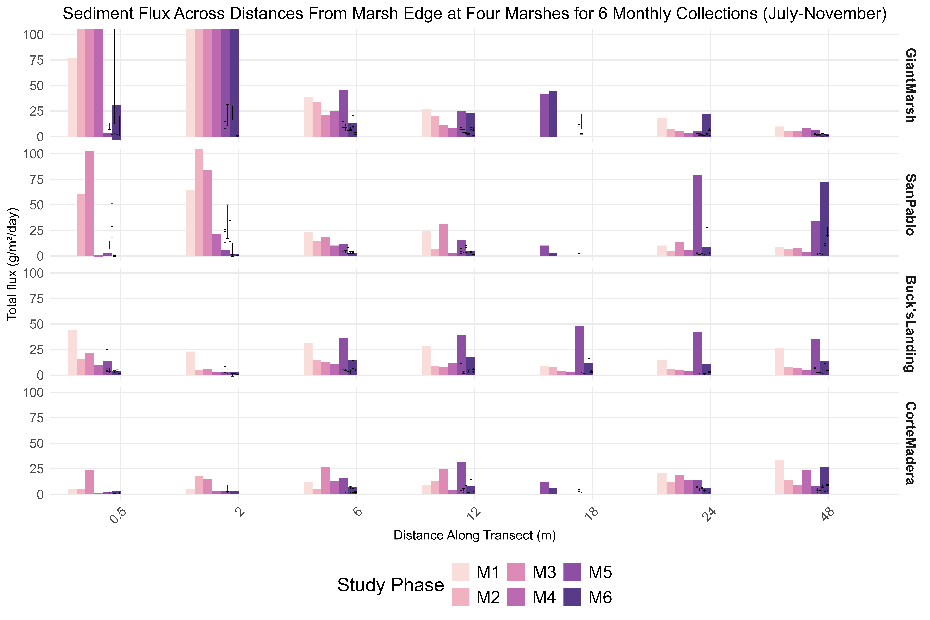
Comparing Elevation of Transect to Each Site
Takeaway: Giant Marsh and San Pablo are 1-0.5 feet taller than Buck’s Landing and Giant Marsh Transects
Takeaway: Measuring Total Sediment, Giant Marsh and San Pablo have the highest rates of sediment deposition

